Slide 1
1D MHD shocks
Justin Angus and Tony Link

Slide 2
Schematic of basic 1D hydrodynamic shock
Lab Frame
Shock Frame
u₁
u₂
u₁-u_{s}
u₂-u_{s}
u_{s}
𝜌₁, P₁
(up stream)
𝜌₂, P₂
(down stream)
𝜌₁, P₁
(up stream)
𝜌₂, P₂
(down stream)

Slide 3
1D Euler Equations
γ is the adiabatic coefficient (5/3 for ideal gas) and P is the pressure

Slide 4
Jump conditions
Lab Frame
Frame where upstream fluid is at rest

Slide 5
Reduced Expressions and expression for density ratio
Working in the frame where upstream fluid is at rest, the mass conservation law can be inserted into the momentum and energy conservation equations, respectively, to give
These two equations can be combined to give the expression for the density ratio
Density jump is 4 for ideal gas in strong shock limit (P₂>>P₁)

Slide 6
Shock speed and downstream speed
The shock speed can be determined by inserting the expression for the density ratio into
The downstream speed can be determined by inserting above expression for u_{s}-u₁ into

Slide 7
Summary of strong shock (P₂>>P₁) expressions
When the up stream fluid is at rest (u₁=0)
post-shock ram energy density is equal to the post-shock thermal energy density
shock moves faster than u₂ by (γ +1)/2

Slide 8
Entropy increase across shock

Slide 9
1D ideal MHD Equations (B normal to U)

Slide 10
Magnetic piston driven shocks in 1D MHD are the same as 1D Euler for small skin depth
The magnetic field diffuses in a skin current layer and JxB pushes the plasma up stream
There is no upstream B and B just inside the shock layer
Assuming that the skin depth is small compared to the shock layer, then the equations on either side of the shock front all the way back to the skin layer downstream are exactly 1D Euler and so all the shock conditions previously obtained hold
P* is constant on either side of the shock and the total downstream pressure (P*₂) transitions from all thermal to all magnetic as you cross the skin layer

Slide 11
Magnetic piston diagram (lab frame, u1=0)
Skin layer
Background gas
Post-shock plasma
Power input (dielectric surface)
u₂
Vacuum region
u_{s}
𝜌₁, P₁
(up stream)
𝜌₂, P₂
(down stream)

Slide 12
2-fluid model: quasi-neutral, inertia-less electrons, and negligible viscosity and heat flux (except in shock front)

Slide 13
2-Temp MHD model: Same as before, just rearranged some terms/equations

Slide 14
1D simplifications:

Slide 15
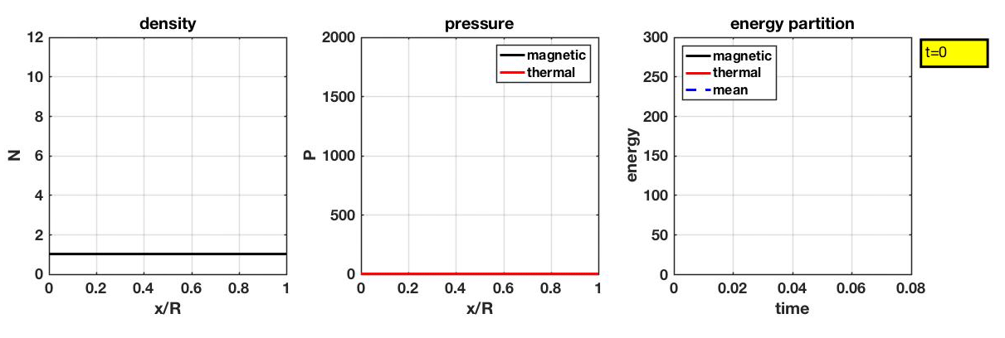
1D MHD Shock in Cartesian at 1MA/3Torr/3cm

Slide 16
Stagnation occurs at x=R/10 in Cartesian

Slide 17
Rate of Energy input into magnetic field is the same as rate of energy input into plasma for small skin layer
From Ampere’s law
E_{z}(R) and B_{y}(R) are fields at r=R
u_{x2} is piston velocity at skin layer
From Logic (B propagates in like a square pulse)
From total energy conservation

Slide 18
thermal energy at stagnation equals energy stored in magnetic field

Slide 19
Average temperate at stagnation is what formula predicts

Slide 20
Pressure increase by factor of 6 at stagnation
All energy in plasma is thermal
Energy in plasma equals that in magnetic field
Magnetic field energy known from radius at stagnation
Total ram energy turns into thermal (factor 2)
R goes from ¼ to 1/10 during stagnation (factor 2.5)
This only gives total of factor of 5 though… the rest of the energy comes from return shock heating, which must come from piston

Slide 21
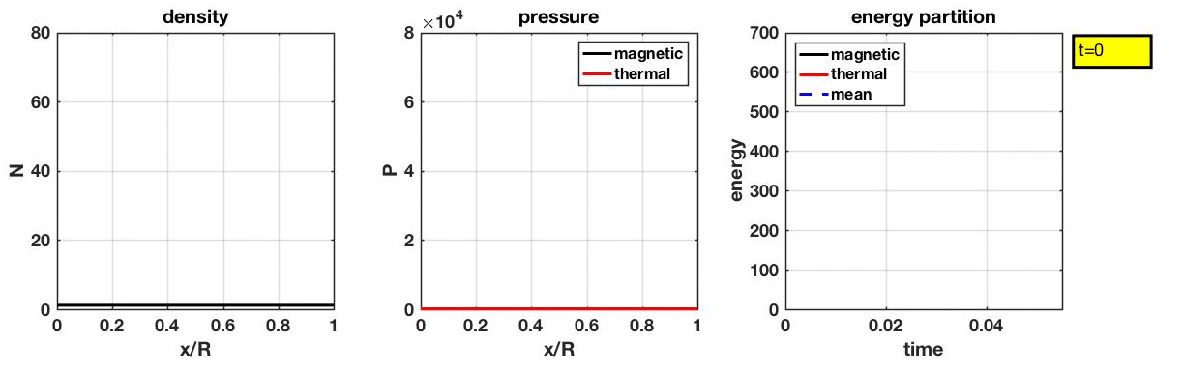
1D MHD Shock in Cylindrical at 1MA/3Torr/3cm

Slide 22
Stagnation occurs at r/R = 0.13 in cylindrical

Slide 23
Rate of Energy input into magnetic field is the same as rate of energy input into plasma for small skin layer even for cylindrical
From Ampere’s law:
From thin skin current
Also from thin skin current
From total energy conservation

Slide 24
Example B_{𝜃} from 1MA/3Torr/3cm run
Skin layer between r1(t) and r2(t)
Magnetic flux/energy in skin layer is much less than that in vacuum for thin skin layer
rB_{𝜃} propagates in like a square pulse

Slide 25
Thermal energy in pinch at stagnation equals energy stored in magnetic field
Average density at stagnation from mass conservation
Magnetic field energy at stagnation can be expressed in terms of current and compression ratio
Average pressure from energy balance equation

Slide 26
1D model gives average temperature at stagnation in terms of energy per unit length in magnetic field, particles per unit length, and adiabatic coefficient
μ₀I²/4𝜋 x ln(R/r_{s}) is energy per unit length in magnetic field at stagnation
𝜋R²n₀ is particles per unit length of plasma being compressed
I is current
γ is adiabatic coefficient (5/3 for ideal gas)
R/r_{s} is compression ratio (1.0/0.13=7.7 from 1D shock calculation)
Larger than Cartesian by 2 ln(0.13)/(1-0.1) = 4.53

Slide 27
Useful form of equation
Last two expressions give <Ti+Te> in units of eV where current I is in MA, anode radius R is in cm, fill density n₀ is in 1/cm³, D2 fill pressure P₀ is in Torr, and γ=5/3 is assumed

Slide 28
Pressure profiles at stagnation from 1MA/3Torr/3cm run in cylindrical matches that from formula
Average normalized density at stagnation from mass conservation is (R/r_{s})² = (1.0/0.13)² = 59
Average normalized total pressure at stagnation from formula is 4.6x10⁴

Slide 29
Ion temperature on axis at stagnation is about 4 times higher than <Ti+Te>/2
Average (Ti+Te)/2 at stagnation from formula is 777 eV
However, most of the pressure is in the ions and density is lower than average on axis, giving peak Ti about a factor of 4 higher than average from formula

Slide 30
On-axis ion temperature actually peaks a little later than stagnation
25 ns

Slide 31
Results are similar at 200kA/1.5Torr/1.5cm
Average (Ti+Te)/2 at stagnation from formula is 240 eV
However, most of the pressure is in the ions and density is lower than average on axis, giving peak Ti about a factor of 4 higher than average from formula

Slide 32
Global energy from MJ and kJ sims show magnetic field energy equals thermal energy at stagnation
1MA/3Torr/3cm
200kA/1.5Torr/1.5cm

Slide 33
r-weighted energy densities at stagnation have same area

Slide 34
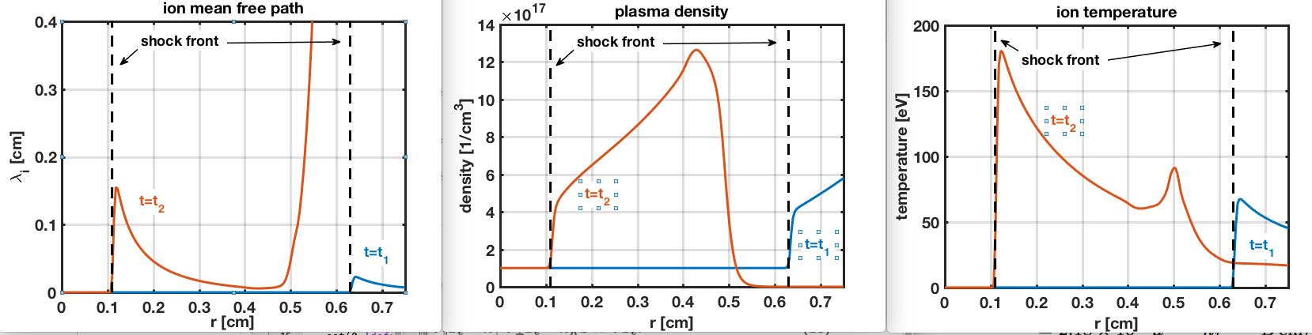
Ion-ion mean free path becomes comparable to shock-front position at about 1mm from axis in kJ-like sim

Slide 35
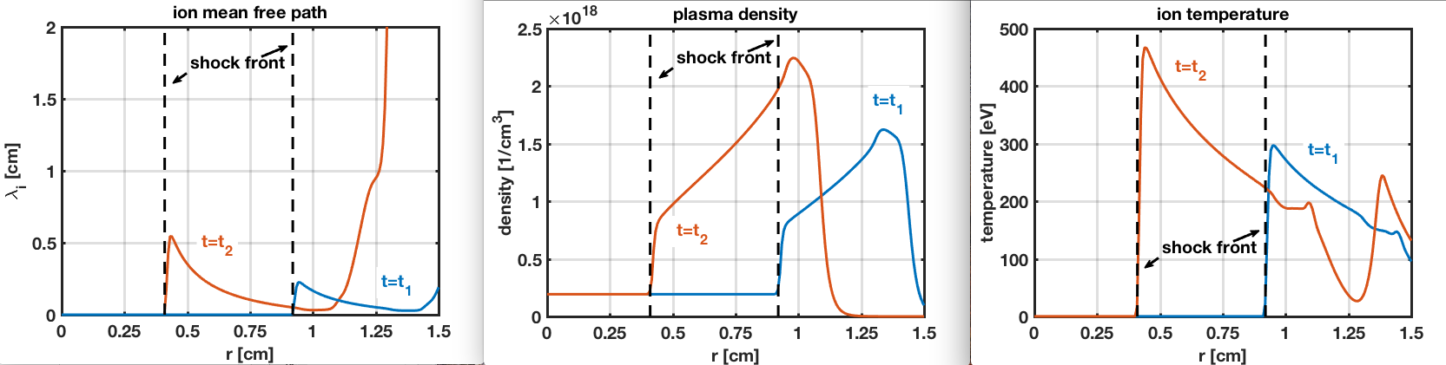
Ion-ion mean free path becomes comparable to shock-front position at about 5mm from axis in MJ-like sim

